Slide 1
ER Diagram
ER Modeling is a “top-down” approach to database design.
ER diagram is the graphical representation of the overall logical structure of the database.
Used at the conceptual design phase of the design process.
Important terms:
Entity sets
Relationship sets
Attributes

Slide 2
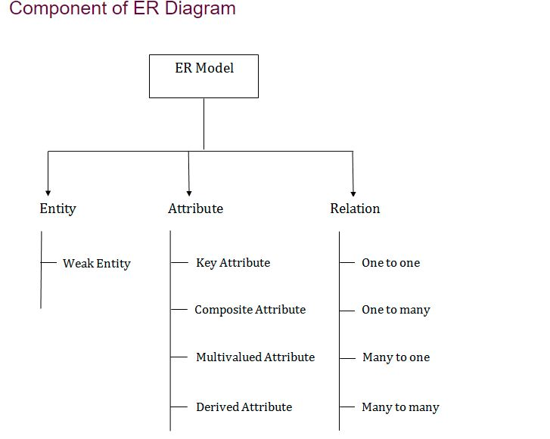

Slide 3
ER modelling
ER modelling : A graphical technique for understanding and organizing the data independent of the actual database implementation
Entity: Any thing that may have an independent existence and about which we intend to collect data. Also known as Entity type.
Entity instance: a particular member of the entity type e.g. a particular student
Attributes: Properties/characteristics that describe entities Relationships: Associations between entities

Slide 4
ENTITY
A real-world thing either living or non-living that is easily recognizable and no recognizable. It is anything in the enterprise that is to be represented in our database. It may be a physical thing or simply a fact about the enterprise or an event that happens in the real world.
An entity can be place, person, object, event or a concept, which stores data in the database. The characteristics of entities are must have an attribute, and a unique key. Every entity is made up of some 'attributes' which represent that entity.

Slide 5
Weak Entity Sets
An entity set that does not have sufficient attributes to form a primary key is termed a weak entity set.
An entity set that has a primary key is termed a strong entity set.
For a weak entity set to be meaningful, it must be associated with another entity set, called the identifying or owner entity set.
The weak entity set is said to be existence dependent on the identifying strong entity set.
The relationship associating the weak entity set with the identifying entity set is called the identifying relationship.
The discriminator is a set of attributes for the weak entity set

Slide 6
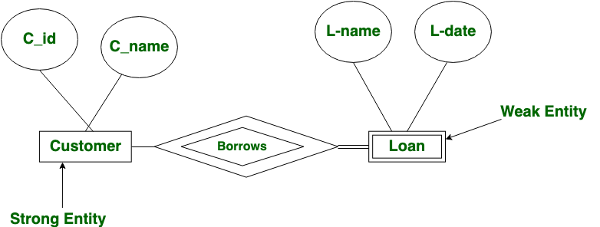
Weak Entities
A weak entity is a type of entity which doesn't have its key attribute. It can be identified uniquely by considering the primary key of another entity. For that, weak entity sets need to have participation.

Slide 7
Strong Entity Set | Weak Entity Set
Strong entity set always has a primary key. | It does not have enough attributes to build a primary key.
It is represented by a rectangle symbol | It is represented by a double rectangle symbol.
The member of a strong entity set is called as dominant entity set. | The member of a weak entity set called as a subordinate entity set.
Primary Key is one of its attributes which helps to identify its member. | In a weak entity set, it is a combination of primary key and partial key of the strong entity set.
In the ER diagram the relationship between two strong entity set shown by using a diamond symbol. | The relationship between one strong and a weak entity set shown by using the double diamond symbol.

Slide 8
Attributes
Types of Attributes | Description
Simple attribute | Simple attributes can't be divided any further. For example, a student's contact number. It is also called an atomic value.
Composite attribute | It is possible to break down composite attribute. For example, a student's full name may be further divided into first name, second name, and last name.
Derived attribute | This type of attribute does not include in the physical database. However, their values are derived from other attributes present in the database. For example, age should not be stored directly. Instead, it should be derived from the DOB of that employee.
Multivalued attribute | Multivalued attributes can have more than one values. For example, a student can have more than one mobile number, email address.

Slide 9
Relationships
A relationship type between two entity types defines the set of all associations between these entity types .
Each instance of the relationship between members of these entity types is called a relationship instance.
E.g if Works-for is the relationship between the Employee entity and the department entity, then Ram works for Comp.sc department, shyam works –for electrical department ..etc are relationship instances of the relationship, works-for

Slide 10
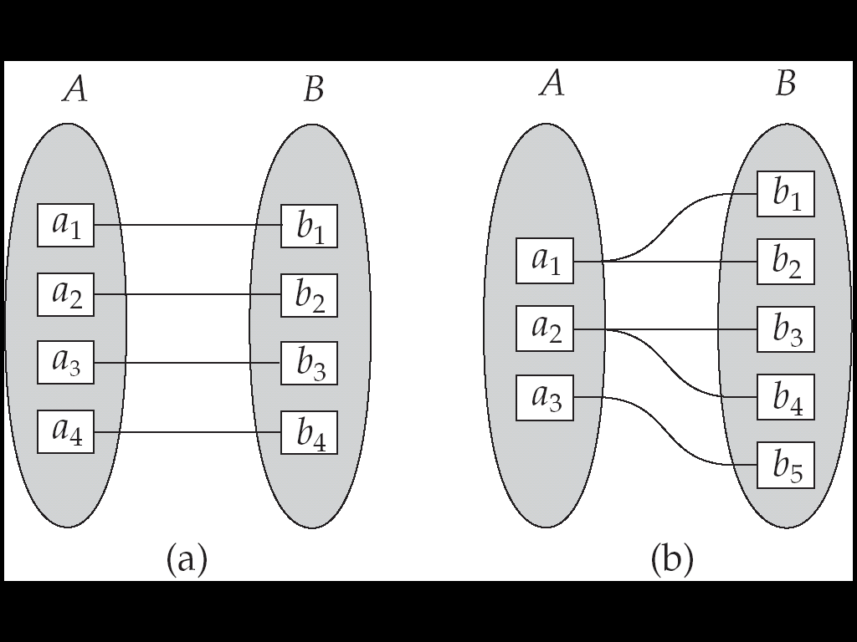
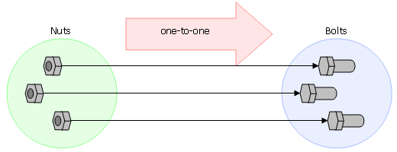
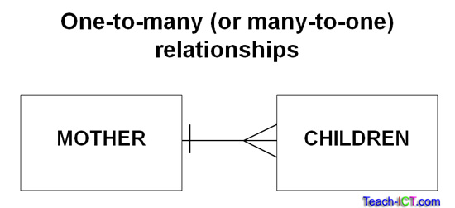

Slide 11
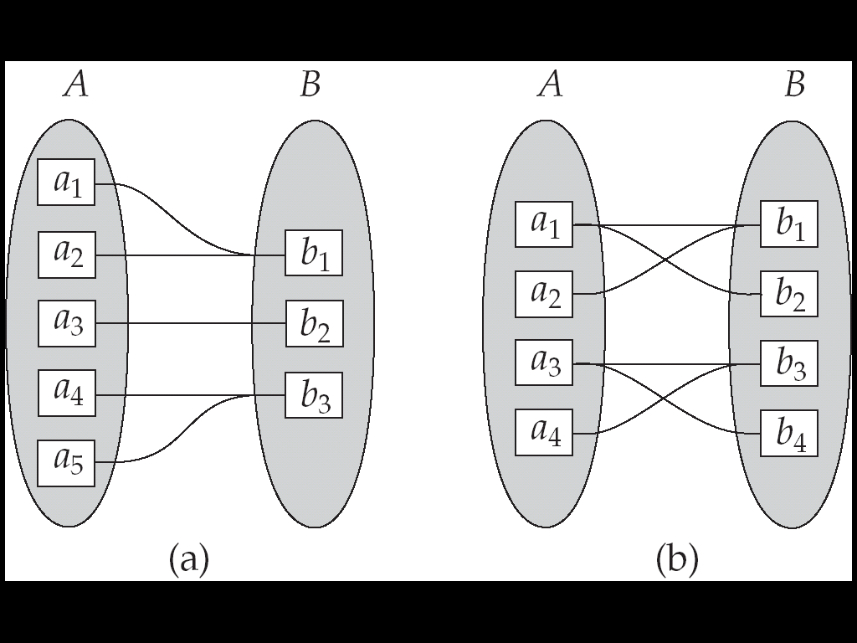
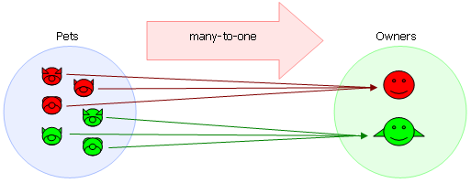
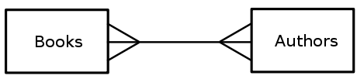
many to many

Slide 12
Mapping Cardinality
One to one (1:1)
One to many(1:M)
Many to one (M:1)
Many to many (M:N)
Note: To distinguish among these types, we draw either a directed line (→ one) or an undirected line (—many) between the relationship set and the entity set.

Slide 13
employee head-of department (1:1)
student enrolls course (m:n)
lecturer offers course (1:n) assuming a course is taught by a single lecturer
Employee worksfor Department(M:1)
The minimum and maximum values of this connectivity is called the cardinality of the relationship

Slide 14
Relationship Participation
Total : Every entity instance must be connected through the relationship to another instance of the other participating entity types
Partial: All instances need not participate

Slide 15

1. Total Participation
It specifies that each entity in the entity set must compulsorily participate in at least one relationship instance in that relationship set.
That is why, it is also called as mandatory participation.
Total participation is represented using a double line between the entity set and relationship set.

Slide 16
Partial Participation-
It specifies that each entity in the entity set may or may not participate in the relationship instance in that relationship set.
That is why, it is also called as optional participation.
Partial participation is represented using a single line between the entity set and relationship set.

Slide 17
Basic Structure of ER Diagram
Rectangles divided into two parts :
The first part contains the name of the entity set.
The second part contains the names of all the attributes of the entity set. Attributes that are part of the primary key are underlined.
Rectangles: This symbol represent entity types
Ellipses : Symbol represent attributes
Diamonds: This symbol represents relationship types
Lines: It links attributes to entity types and entity types with other relationship types
Primary key: attributes are underlined
Double Ellipses: Represent multi-valued attributes

Slide 18
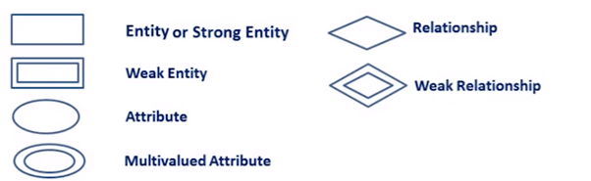
ER Diagram

Slide 19
E R MODEL
A university registrar’s office maintains data about the following entities: (a) courses, including number, title, credits, syllabus, and prerequisites;
(b) course offerings, including course number, year, semester, section number, instructor(s), timings, and classroom;
(c) students, including student-id, name, and program; and
(d) instructors, including identification number, name, department, and title.
Further, the enrollment of students in courses and grades awarded to students in each course they are enrolled for must be appropriately modeled. Construct an E-R diagram for the registrar’s office. Document all assumptions that you make about the mapping constraints

Slide 20
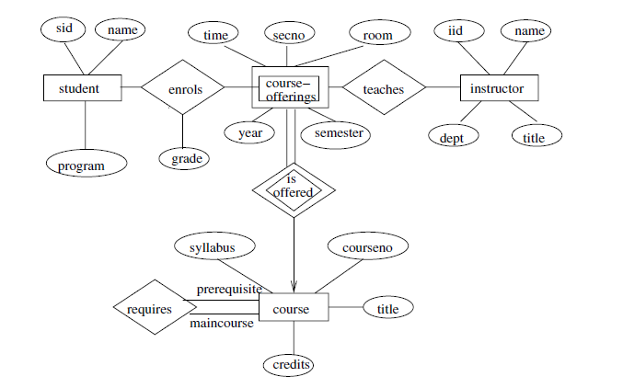

Slide 21
ER Diagram Design Issues

Slide 22
Summary
ER Diagram
Basic structure of ER Diagram
Rectangles
Diamonds
Lines
Undivided rectangles
Dashed lines
Double lines
Double diamonds
Mapping cardinality
Cardinality limits
Composite attributes
Roles
Non-binary relationship sets
Weak entity sets
ER Diagram Design Issues
Use of Entity Sets v/s Attributes
Use of Entity Sets v/s Relationship Sets
Binary v/s n-ary relationships
Placement of Relationship Attributes

